Slide 1
Team working - workshop
PT5051

Slide 2
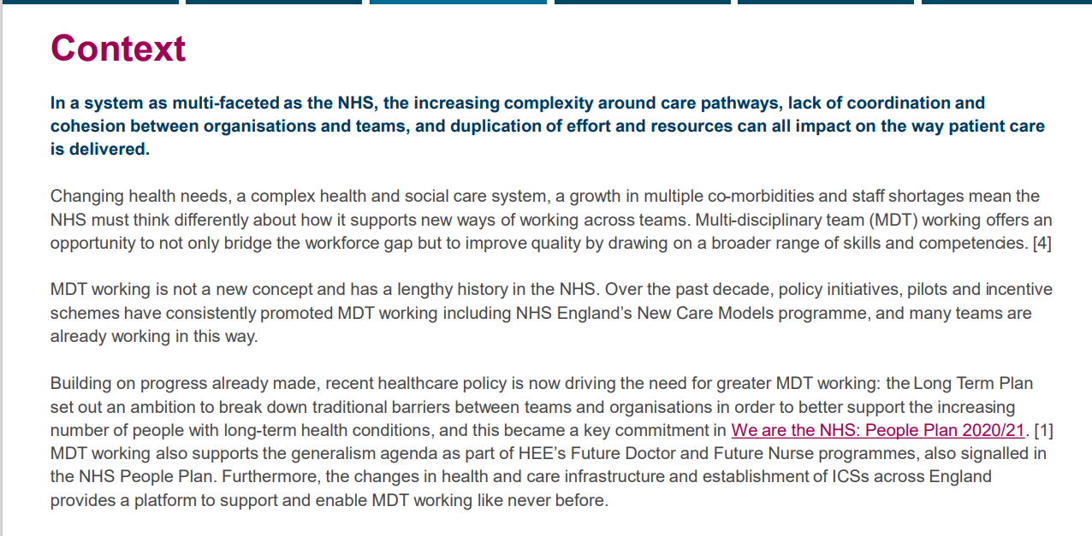

Slide 3
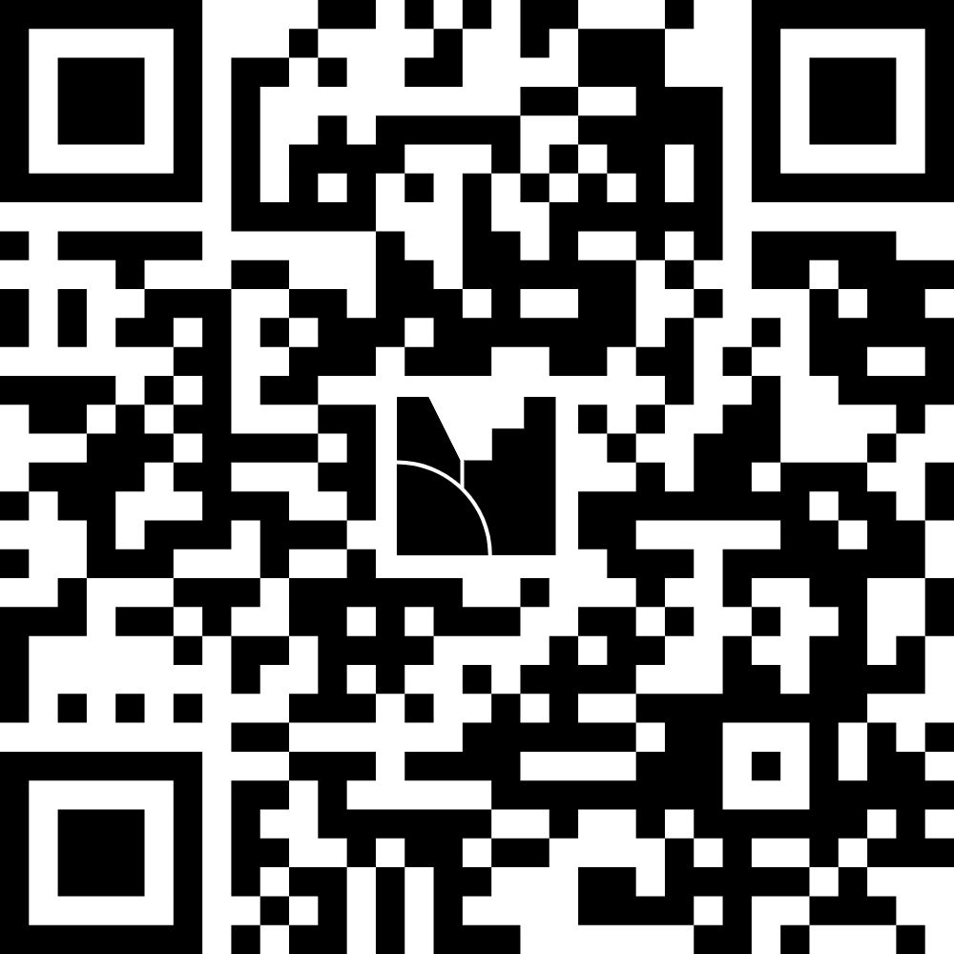
Join the menti - https://www.menti.com/almsddxz7ikv

Slide 4
What are the benefits of team working ?

Slide 5
Define multi-disciplinary working ?

Slide 6
Define interdisciplinary working

Slide 7
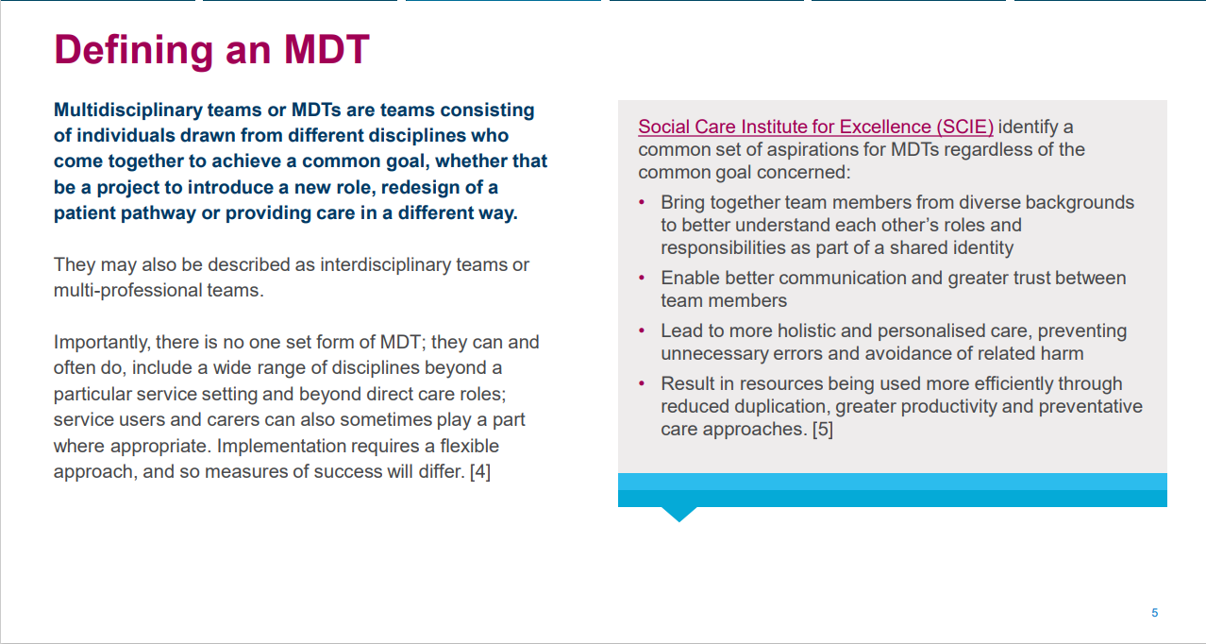

Slide 8
Multi-disciplinary teams
In Oncology
A multidisciplinary team (MDT) in oncology is defined as the cooperation between different specialized professionals involved in cancer care with the overarching goal of improving treatment efficiency and patient care.

Slide 9
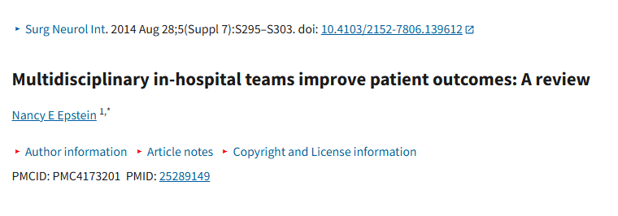

Slide 10
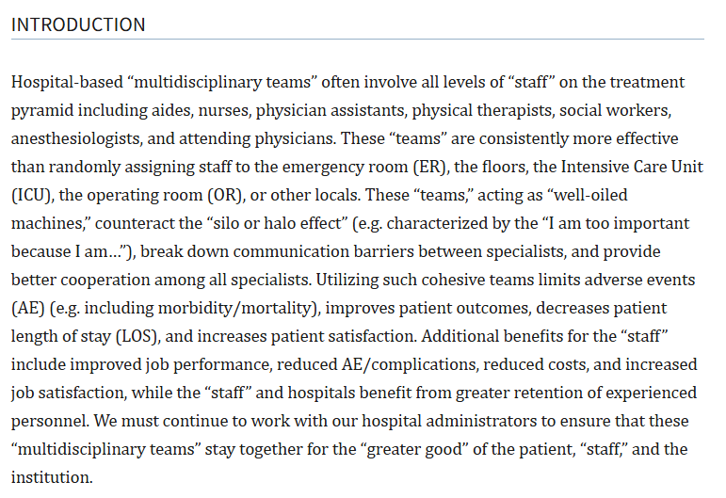

Slide 11
Interdisciplinary team (IDT) working
IDT working involves team members working collaboratively towards a defined common purpose (i.e. a goal); bringing together elements from two or more disciplines by integrating, synthesizing and blending concepts, methods, and tools into one activity to create something new, by thinking across boundaries to solve complex problems

Slide 12
Integrated care systems
https://youtu.be/mz4FFE2y8PM

Slide 13
Integrated Care Teams, working in an interdisciplinary manner.
The multi-disciplinary team as members of more than one profession working independently or in parallel on the same project, coordinating their work.
Inter-disciplinary teams “integrate and translate, themes and schemes shared by several professions”.
hey share a common goal and “is based on an integration of the knowledge and expertise of each professional, so that solutions to complex problems can be proposed in a flexible and open mined way.
There is a step change in the social process and effort that is required for inter-disciplinary working over and above that of multi-disciplinary working.
D’Amour D, Ferrada-Videla M, San Martin Rodriguez L, Beaulieu MD. The conceptual basis for interprofessional collaboration: Core concepts and theoretical frameworks. Journal of Interprofessional Care. 2005 May; 19(sup1): 116–31. DOI:

Slide 14
Menti – Key skills needed for effective teamwork

Slide 15
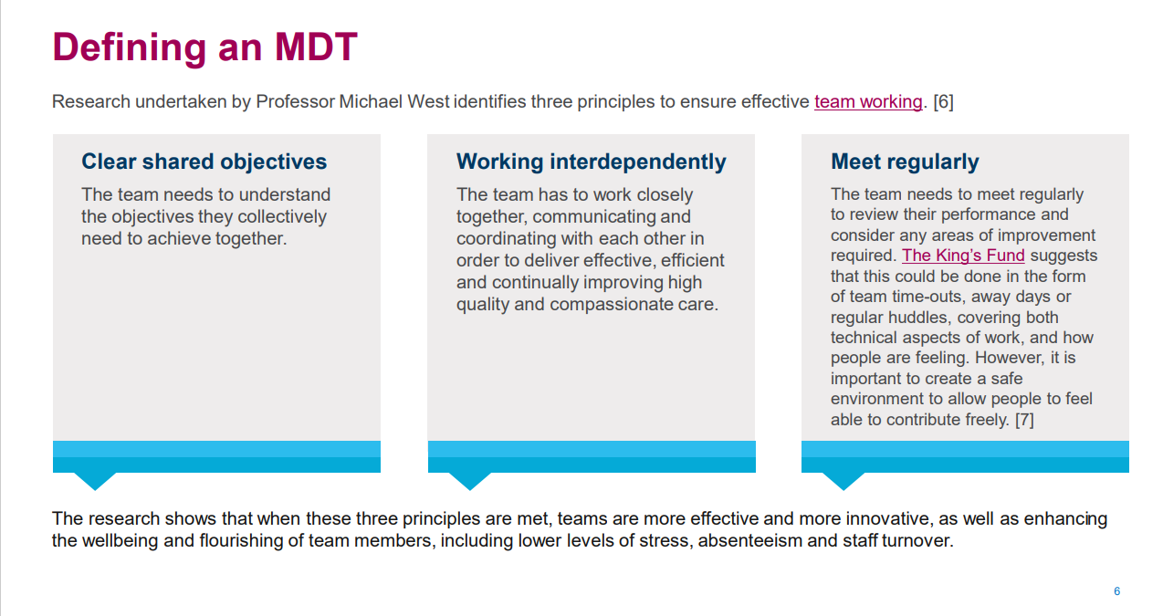

Slide 16
Menti – Challenges of Team Working

Slide 17
Menti- Benefits of Team working

Slide 18
Your experiences
Think back to your placement experiences.
Discuss in your groups –
  Each describe one positive experience of team working
  Each describe a challenge
  What contributed to it either being positive or challenging ?
  Were the challenges overcome ?
  What skills were used.
  Use the padlet to record your thoughts and feedback to the group

Slide 19
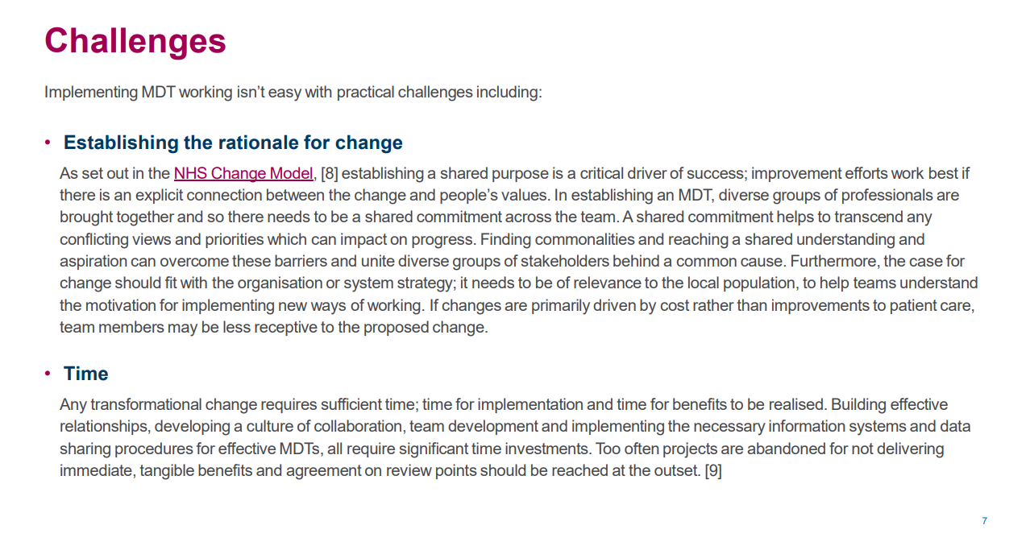

Slide 20
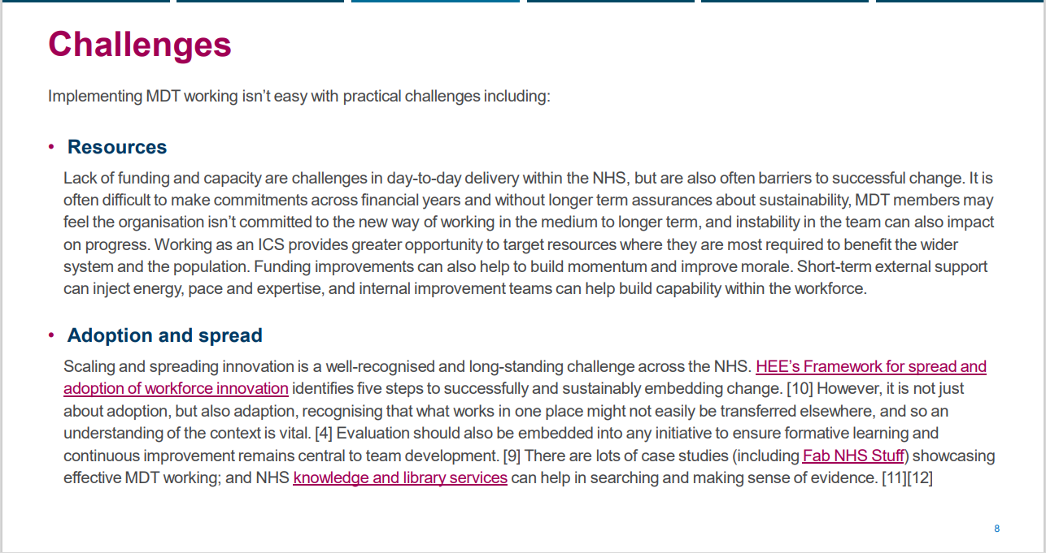

Slide 21
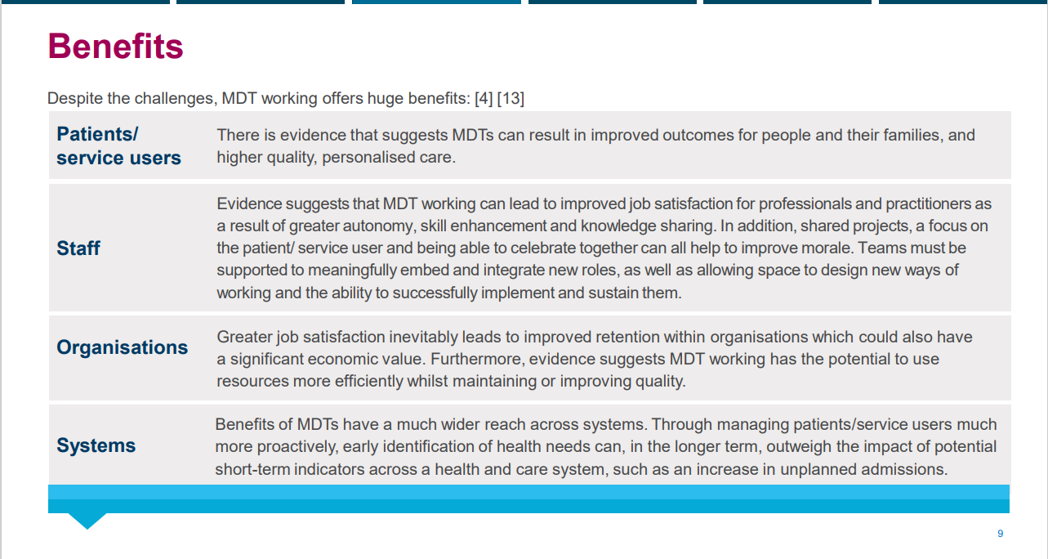

Slide 22
What’s next
Plans for 21/10
PT5051 will run in the morning and you will be working with the BSc Dietetic and Nutrition students.
You will be in SC253
You will learn to
  Assess height and weight
  Understand about how a dietitian would assess a patient
  Learn about the communication skills require to illicit information using dietary information

